Slide 1
Micro Credit Defaulter Project
By JESSICA GHIMELIYA

Slide 2
Abstract
This project would not have seen the light of the day without the following people and their priceless support and cooperation. Hence I extend my gratitude to all of them.
A Microfinance Institution (MFI) is an organization that offers financial services to low income populations. MFS becomes very useful when targeting especially the unbanked poor families living in remote areas with not much sources of income. The Microfinance services (MFS) provided by MFI are Group Loans, Agricultural Loans, Individual Business Loans and so on.
Many microfinance institutions (MFI), experts and donors are supporting the idea of using mobile financial services (MFS) which they feel are more convenient and efficient, and cost saving, than the traditional high-touch model used since long for the purpose of delivering microfinance services.
The sample data is provided to us from our client database. It is hereby given to you for this exercise. In order to improve the selection of customers for the credit, the client wants some predictions that could help them in further investment and improvement in selection of customers.

Slide 3
Introduction
Though, the MFI industry is primarily focusing on low income families and are very useful in such areas, the implementation of MFS has been uneven with both significant challenges and successes.
Today, microfinance is widely accepted as a poverty-reduction tool, representing $70 billion in outstanding loans and a global outreach of 200 million clients.
We are working with one such client that is in Telecom Industry. They are a fixed wireless telecommunications network provider. They have launched various products and have developed its business and organization based on the budget operator model, offering better products at Lower Prices to all value conscious customers through a strategy of disruptive innovation that focuses on the subscriber.
They understand the importance of communication and how it affects a person’s life, thus, focusing on providing their services and products to low income families and poor customers that can help them in the need of hour.

Slide 4
Motivation for the Problem Undertaken
Our main objective of doing this project is to build a model to predict whether the users are paying the loan within the due date or not. We are going to predict by using Machine Learning algorithms. The sample data is provided to us from our client database. In order to improve the selection of customers for the credit, the client wants some predictions that could help them in further investment and improvement in selection of customers. Learning about real world business problems and become Data Scientist is only motive to get hands on this project. Working on Micro Finance and Credit is a part of my Internship with FlipRobo Technologies. This project is provided by the company to get some touch of real time or real world problems, and to perform well in this project to show my capabilities is the motivation behind doing this project.

Slide 5
Goal/Target:-
Build a model which can be used to predict in terms of a probability for each loan transaction, whether the customer will be paying back the loaned amount within 5 days of insurance of loan. In this case, Label ‘1’ indicates that the loan has been paid i.e. Non- defaulter, while, Label ‘0’ indicates that the loan has not been paid i.e. defaulter.
Steps Are Follows:-
Perform proper data cleaning.
Focus on data visualization and infer details from it.
Use 4-5 models for training, do proper hyper parameter tuning and choose the right evaluation metrics to finalize your model.
Create a detailed report mentioning all the steps in the format of sample documentation file.
Create a PowerPoint presentation of the project.
- Test your predictions on multiple metrics like ROC-AUC curve, accuracy, Recall and Precision.

Slide 6
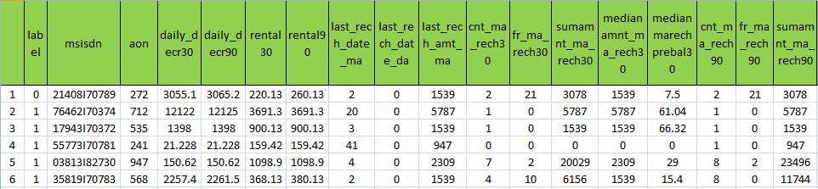
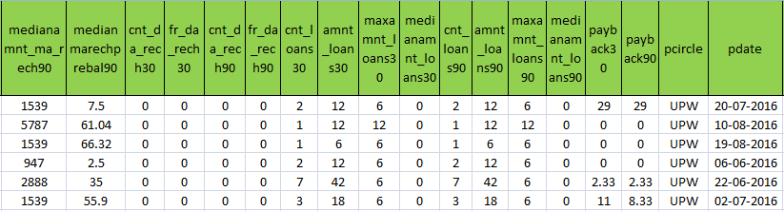
Sample Data Set:

Slide 7
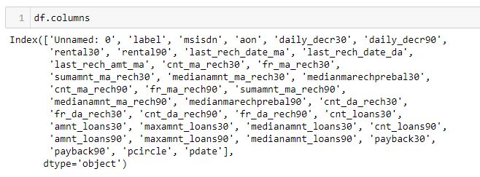
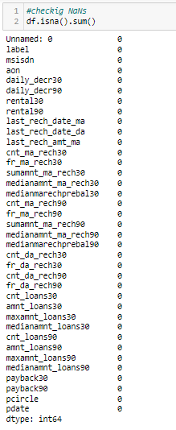
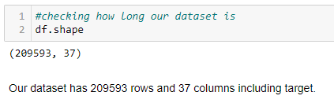
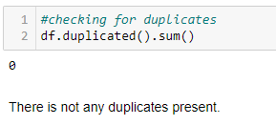
Basic Information of the Dataset
Checking
Missing
Values

Slide 8
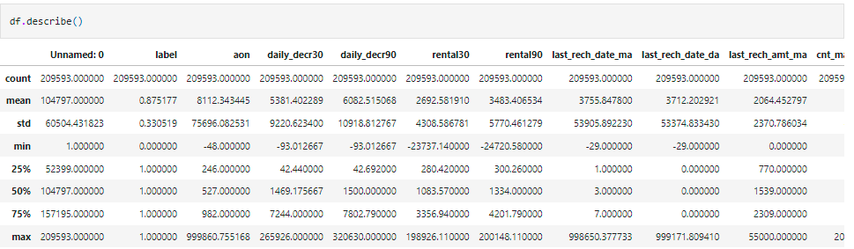
Statistical Summary
Observation:
Unnamed:0 feature is a kind of serial number , so it is not related with target variable, we will delete in further steps.
Some features like aon, daily_decr30, daily_decr90,rental30,last_rech
date_ma,last_rech_amt_ma,cnt_ma_rech30, fr_ma_rech30 and many more features have not appropriate distributed data, i.e. that the difference between min value and max value is very high. It is not in acceptable range. we will handle it later.
Some features have high standard deviation than it's mean value, which is not acceptable.

Slide 9
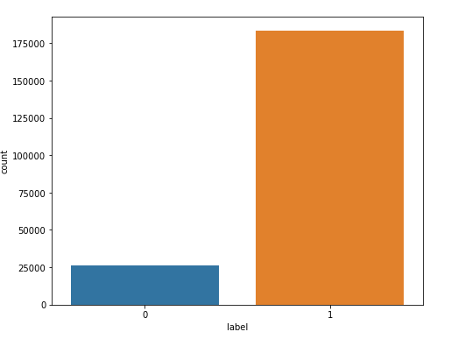
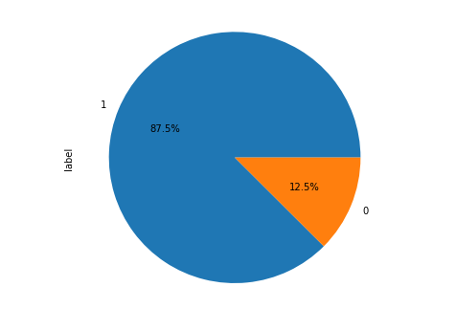
Unbalancing Data Set
We can see the imbalanced dataset here.
As we can from above graph 87.5% customers are paid it's credit card payment but 12.5% customers are not paid.
So that we can say that we have biased class, which is the distinctive example of Imbalanced Classification Problem. We will use Over-Sampling or Under-Sampling technique to handle this type of problem. We will take care of it before model building.

Slide 10
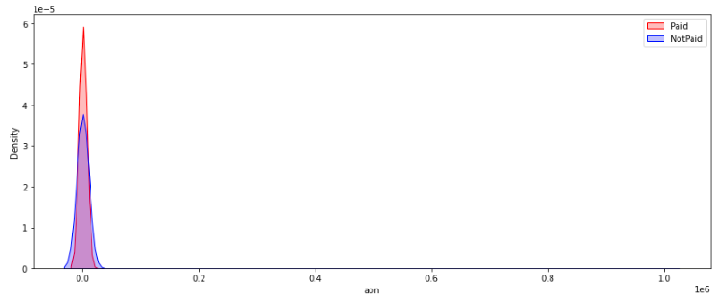
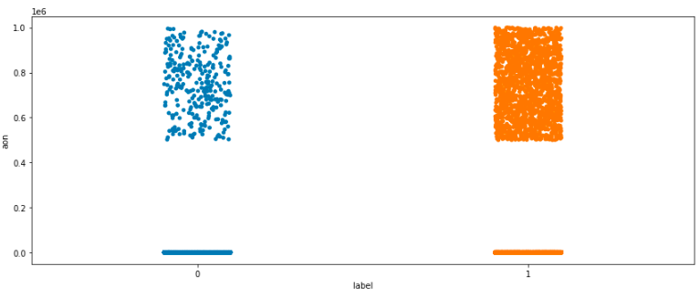
Visualization
Observation:
As we can see in the first figure that most of the data points fall between 0 to 0.05 le^6.
As less number of age on cellular network(in days), as higher chance of user paid back the credit amount.
we can not differentiate with paid or non paid graph so we can say that there is negligible relation or no relation between feature and target.

Slide 11
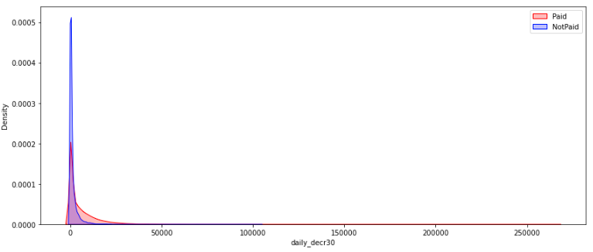
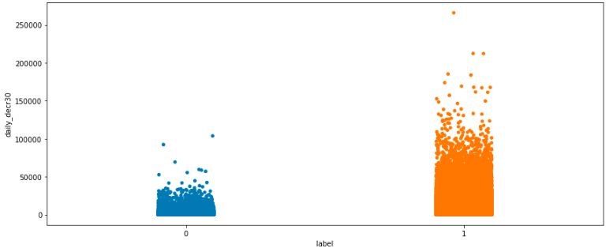
Daily amount spent from main account, (averaged over last 30 days)
observation:-
Daily amount spent from main account when its 0, there is high chance the user did not paid, but as daily amount spent from main account increases the user paid back the credit amount.

Slide 12
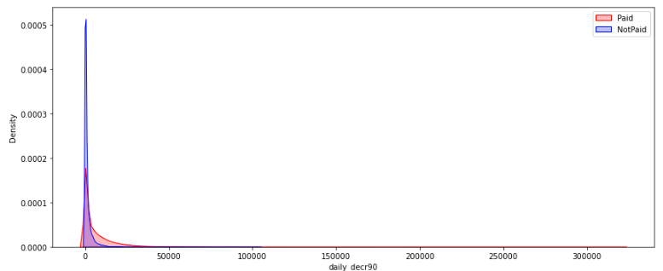
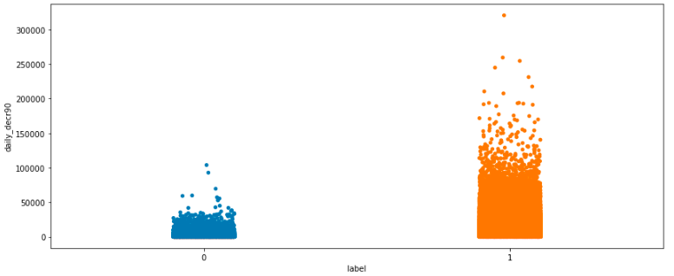
Daily amount spent from main account (averaged over last 90 days)
observation:-
As we have seen previously that as Daily amount of user's main account is increases than it's high probability that user paid back it's credit amount.

Slide 13
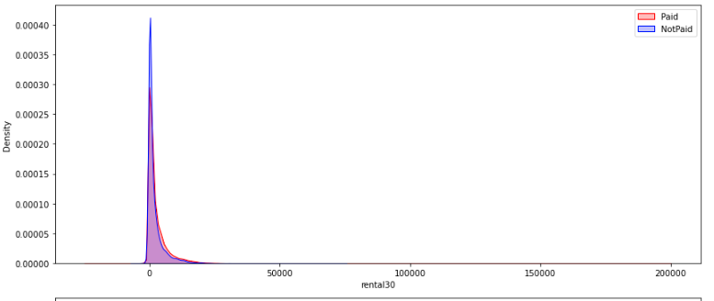
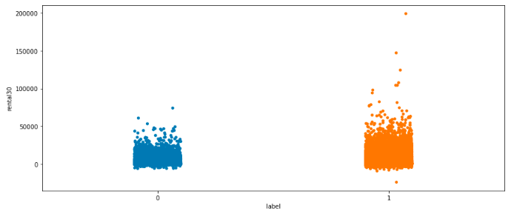
rental30:-Average main account balance (last 30 days)
Observation:-
Most of the users did not maintain it's account. Their account balance is zero that's why they fraud with the company.
As we seen that as Avg main balance is increasing the chance is also increasing that user paid back to us.

Slide 14
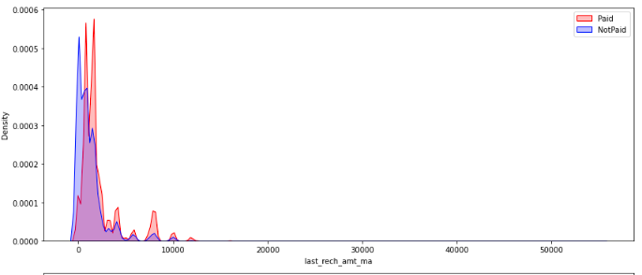
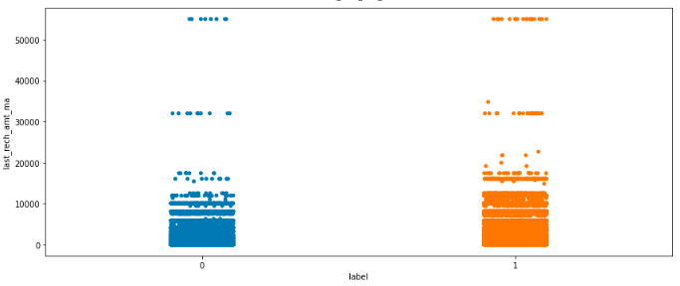
last_rech_amt_ma:- Amount of last recharge of main account
Observation:-
We can easily see that When last recharge is zero, then the fraud chance is very high, but as the amount of recharge is increasing the fraud chance decreasing drastically. It mean we can say that as recharge amount increasing the possibility also increasing that user paid back its credit amount.

Slide 15
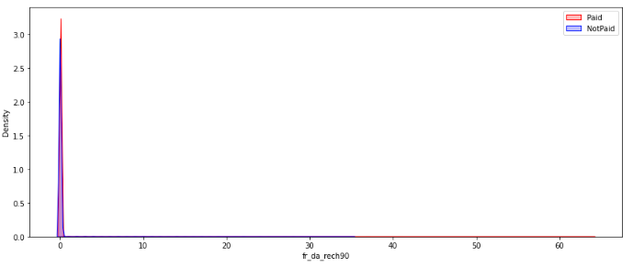
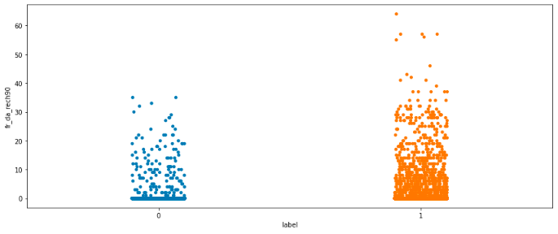
fr_da_rech90:- Frequency of data account recharged (last 90 days)
Observation:-
if the frequency of number, when data account got recharged, has gone above 35 then there is no chance that user found cheated.

Slide 16
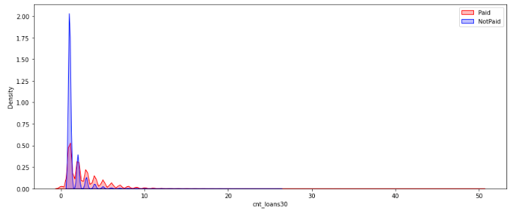
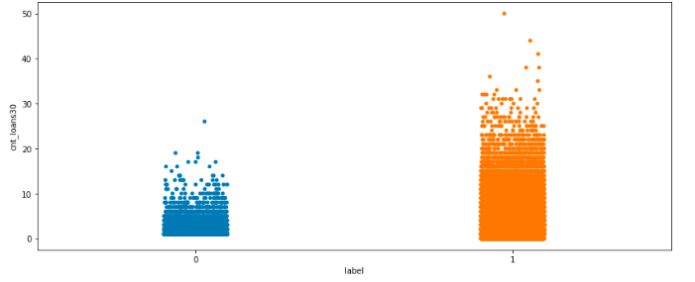
cnt_loans30:- Number of loans taken by user (last 30 days)
Observation:
It interesting that when user did not take any loan, that time they cheat with company.
If user take loan more than 5 times there is less chance that user will cheat with company.

Slide 17
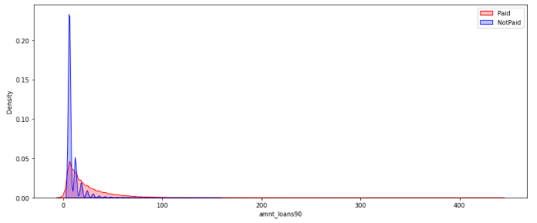
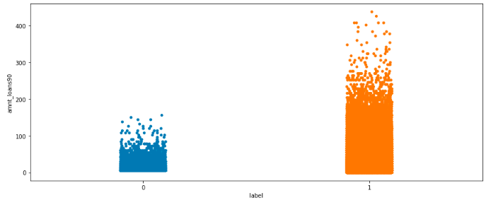
amnt_loans90:- Total amount of loans taken by user (last 90 days)
Observation:
We can see clear up-trend here. As loan amount increasing than chances of scam is getting down.
And if the loan amount is above 200 then scam chances is become 0%.

Slide 18
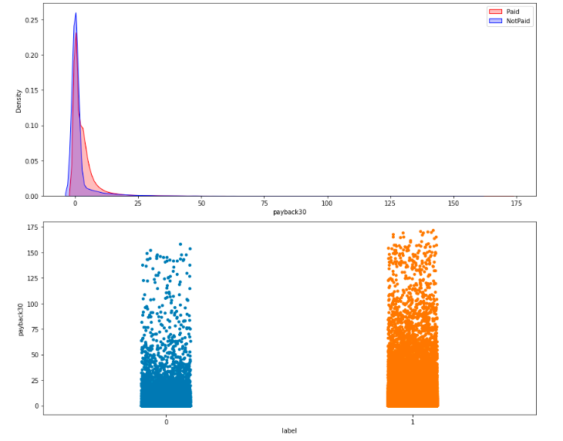
payback30:- Average payback time in days over (last 30 days)
There is very less relation between payback30 feature with target.
both graph showing parallel relation with target.

Slide 19
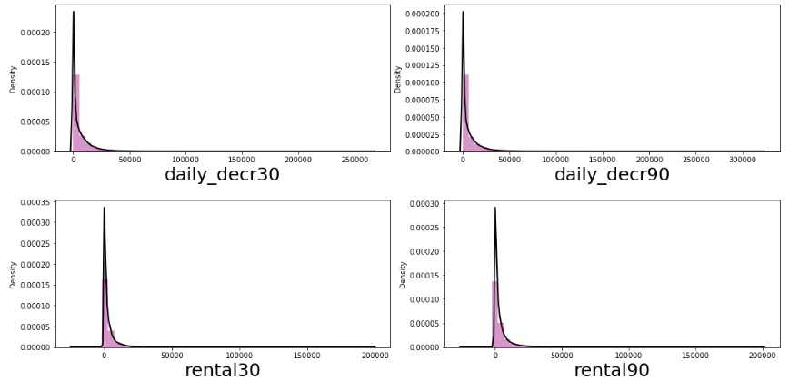
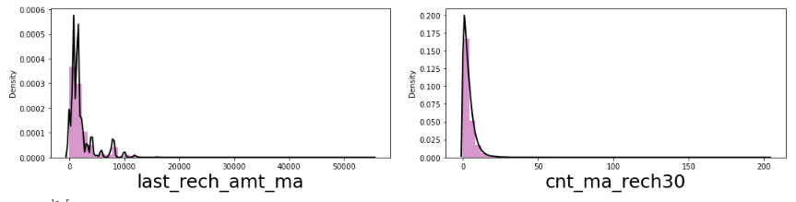
Distribution of continuous data

Slide 20
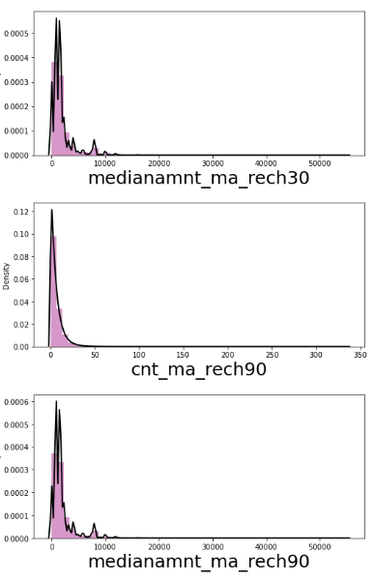
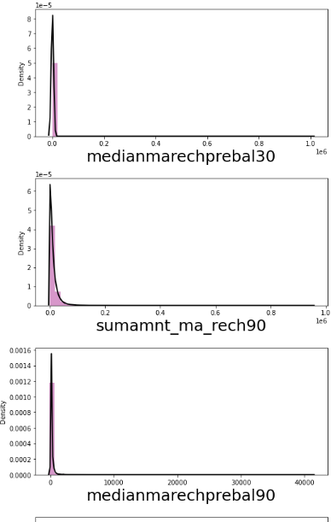
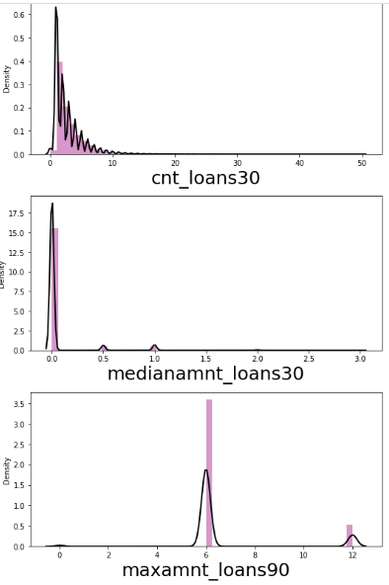
Distribution of continuous data

Slide 21
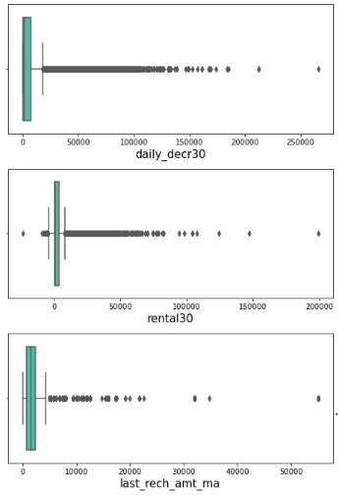
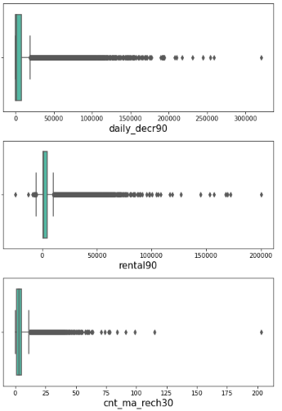
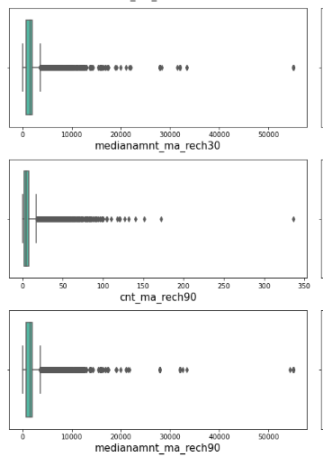
Checking Outliers
Lots of Outliers

Slide 22
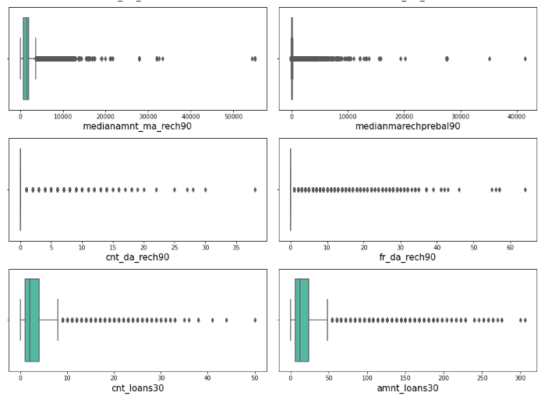
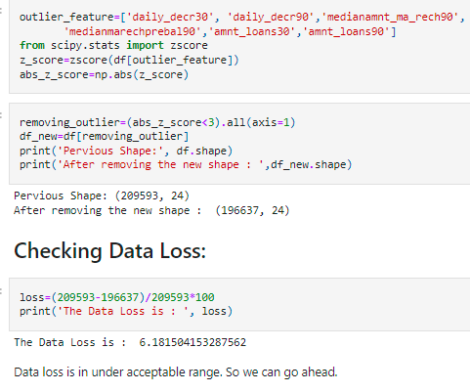
Handling Outliers
Outliers
Using Zscore

Slide 23
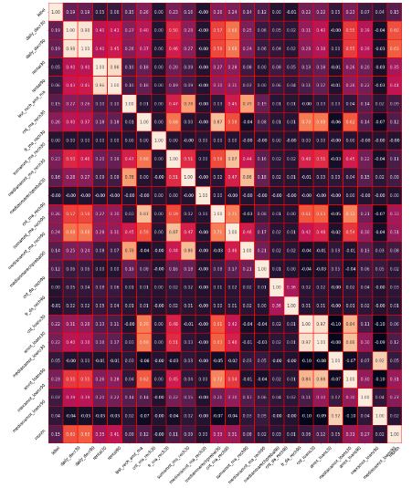
Heat Map
Multi-Collinearity
Multi-Collinearity

Slide 24
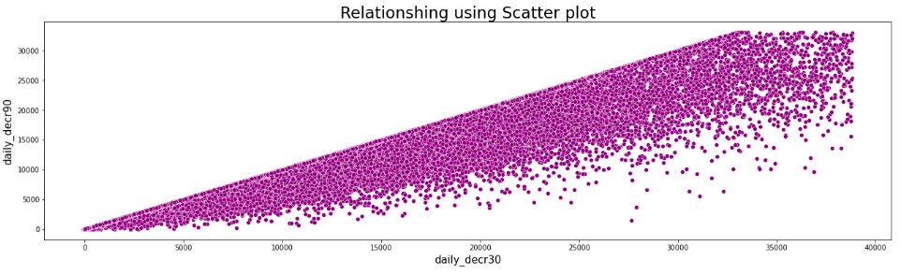

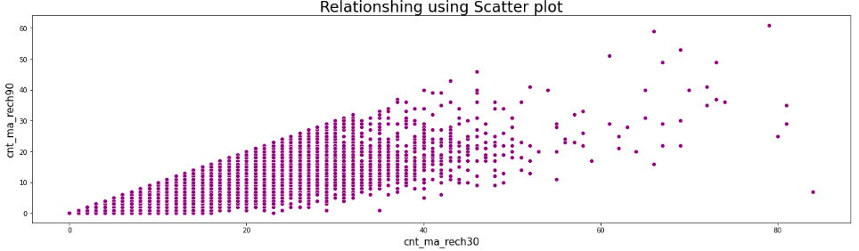
Feature Vs Feature

Slide 25

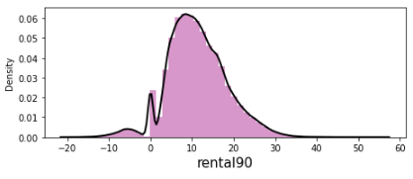
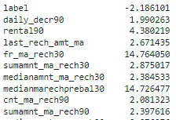
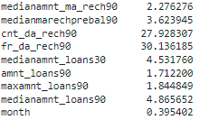
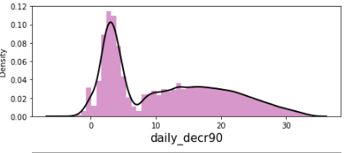
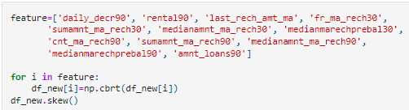
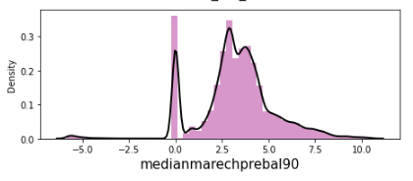
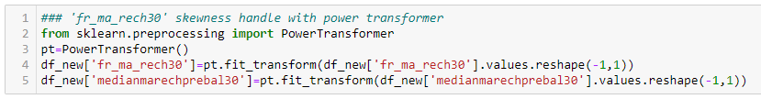
Checking Skewness
Distribution After Transformation
Well Distributed now

Slide 26
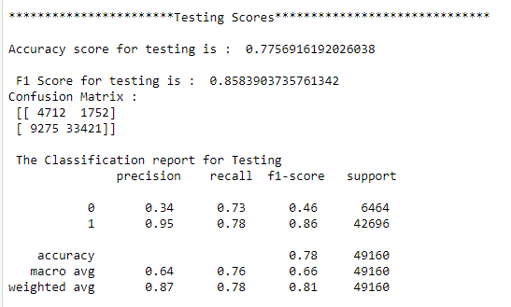
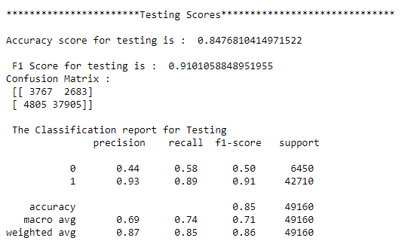
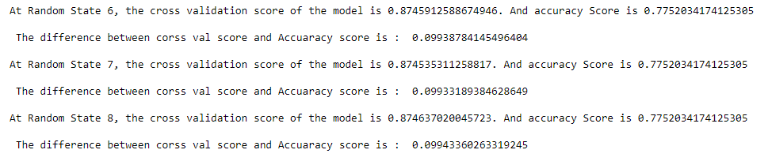
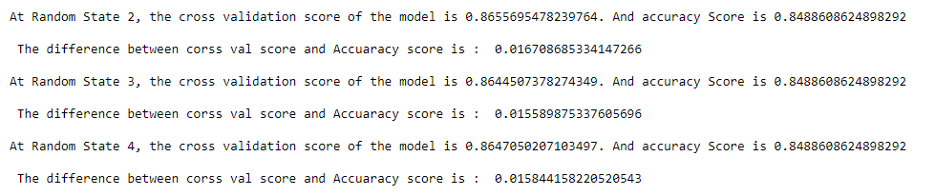
Printing the All Model’s Scores And Compare
Logistic Regression
Decision Tree Classifier

Slide 27




Printing the All Model’s Scores And Compare
K-Nearest Classifier
AdaBoost Classifier

Slide 28




Printing the All Model’s Scores And Compare
Random Forest Classifier
Gradient Boosting Classifier

Slide 29




Printing the All Model’s Scores And Compare
Naïve Bayes Classifier
Extra Tree Classifier

Slide 30



Hyper Parameter Tuning

Slide 31




RFC Model Evaluation

Slide 32

Actual Vs Predicted
Random Forest Classifier with 82% Accuracy.

Slide 33
Conclusion
In my opinion, the outcomes demonstrate that IMF is making a positive impact on the lives of the citizens in the world who are particularly from weaker sections. During the study I found out that the bank has been allowing and supporting Group formation, encouraging savings and monitoring the inter-loaning structure.
This model will be good way for the management to understand whether the customer will be paying back the loaned amount with in 5 days of insurance of loan. The relationship between predicting defaulter and the economy in an important motivating factor for predicting micro credit defaulter.

Slide 34
Future Work And Scope
Due to the time limit, it is not possible to conduct a thorough study and have a deep understanding of the dataset. There are still many features in the dataset that are unused and a lot of the information has not been fully digested with knowledge in the banking industry.
It is important to notice this fact that the default loans are only about 10% of the total loans, thus during the training process, the model will favour predicting more negatives than positive results. We have already used the F1 score and ROC AUC instead of just accuracy. However, the performance is still not as good as it could be. In order to solve this problem, other methods such as collecting or resampling more data can be used in the future.

Slide 35


